Slide 1
Software
Development
I work with computers building applications and software

Slide 2

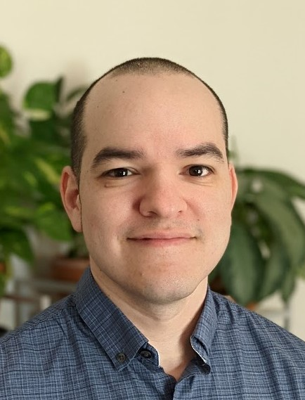
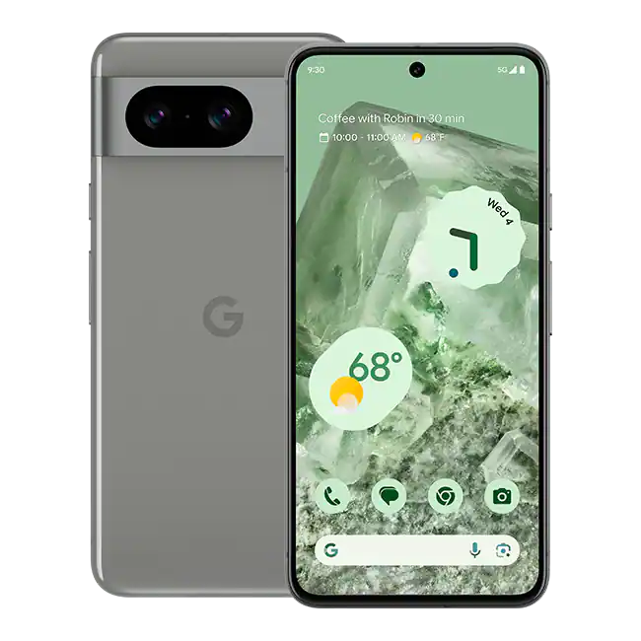

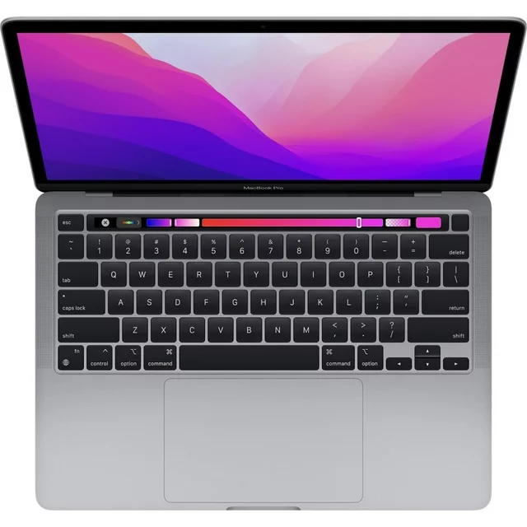
Who am I
Daniel
Software Developer at USAA
Notes:
Name - where i work - job title - what i do

Slide 3


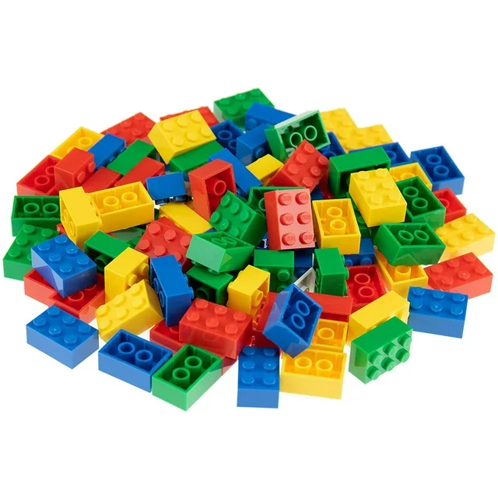
Who here likes….
Computers & Technology
Puzzles
Solving Problems
Building things
Notes:
Build engagement by asking and getting hands up

Slide 4
If you like any of these
Technology
Puzzles
Solving Problems
Building things
Maybe you should work with computers growing up
Notes:
A lot of these pertain to software development
Use Technology all day
Solving problems
The things I build ar a lot of other things put together, just like legos and doing puzzles

Slide 5
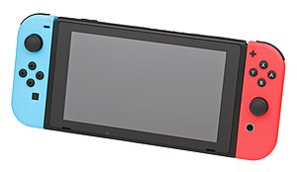
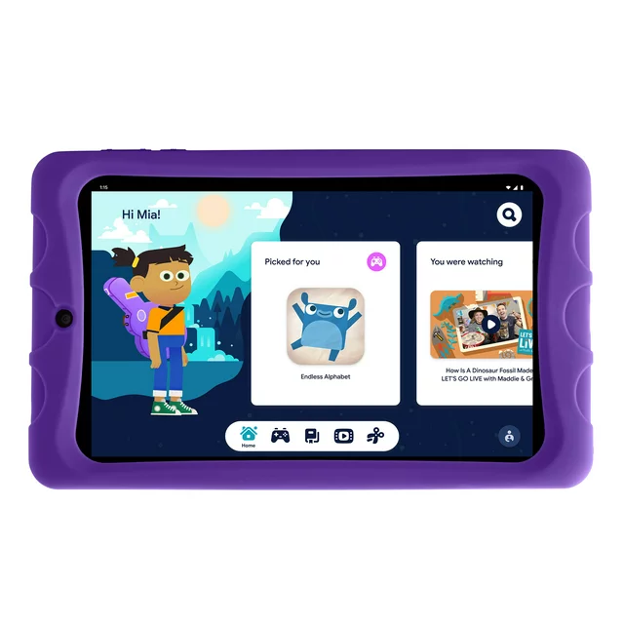
Are these computers?
Notes:
Next few slides are just trying to bridge concepts

Slide 6
Computer
A Machine that can be coded with instructions to do something

Slide 7
These are all computers!

Slide 8
Software/Apps
Instructions that tell a computer what to do

Slide 9
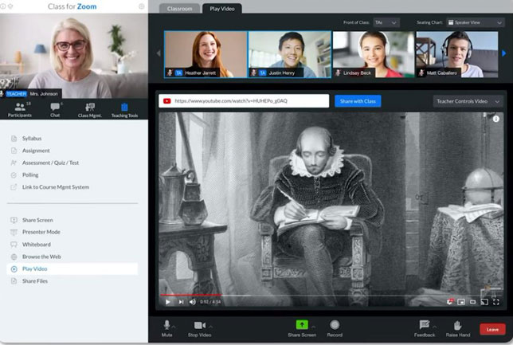
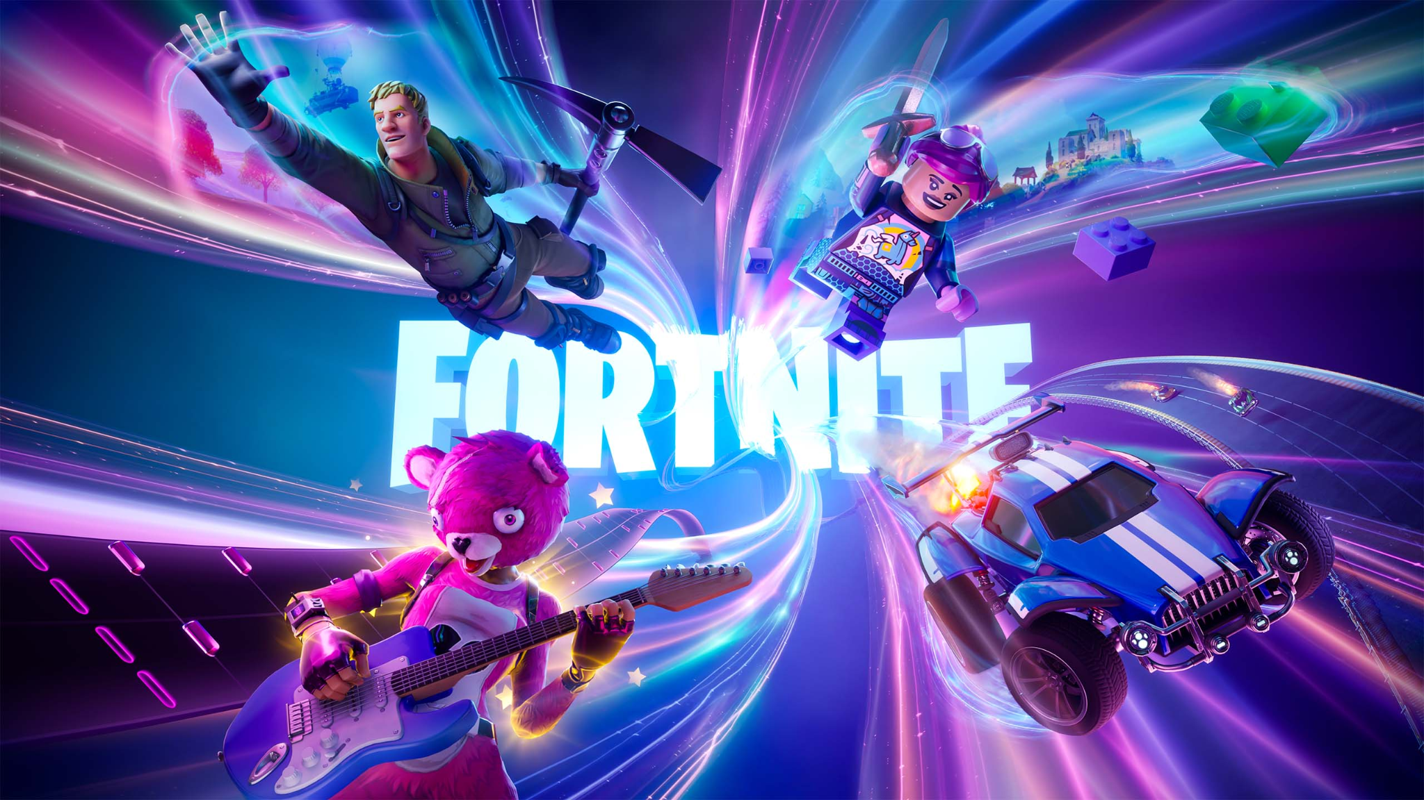
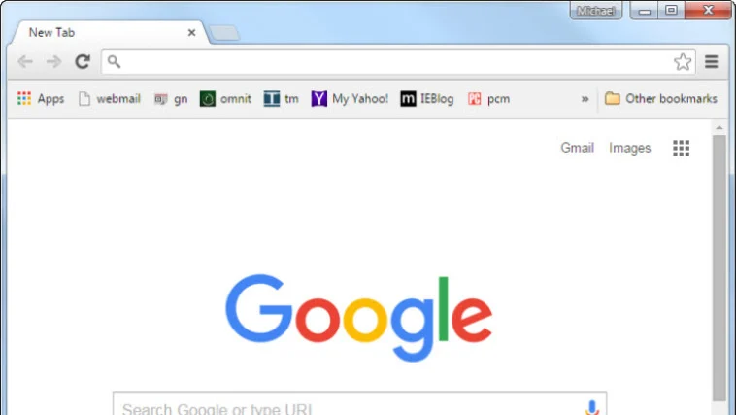
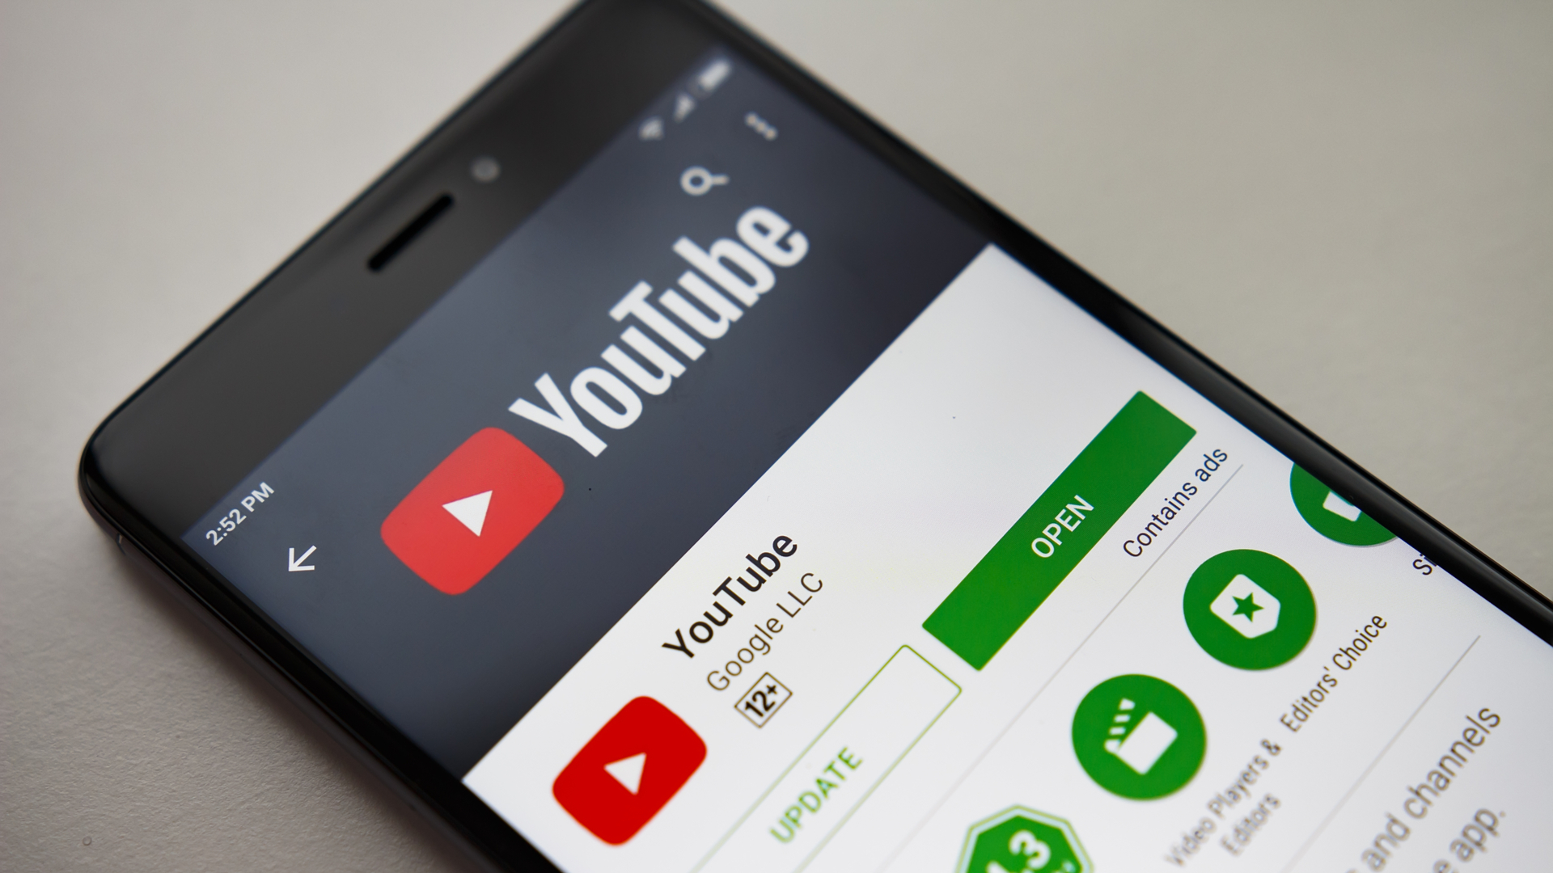
These are all software!
Notes:
Zoom - probably used it when you had school at home
Web Browesr - for searching the internet
Fortnite - game, video games are software
Youtube - software for watching videos

Slide 10
What is my job?
I make software for computers
Notes:
Meaning I build instruction for machines, so they can do something.
Remember, machines can be computers and cell phones

Slide 11
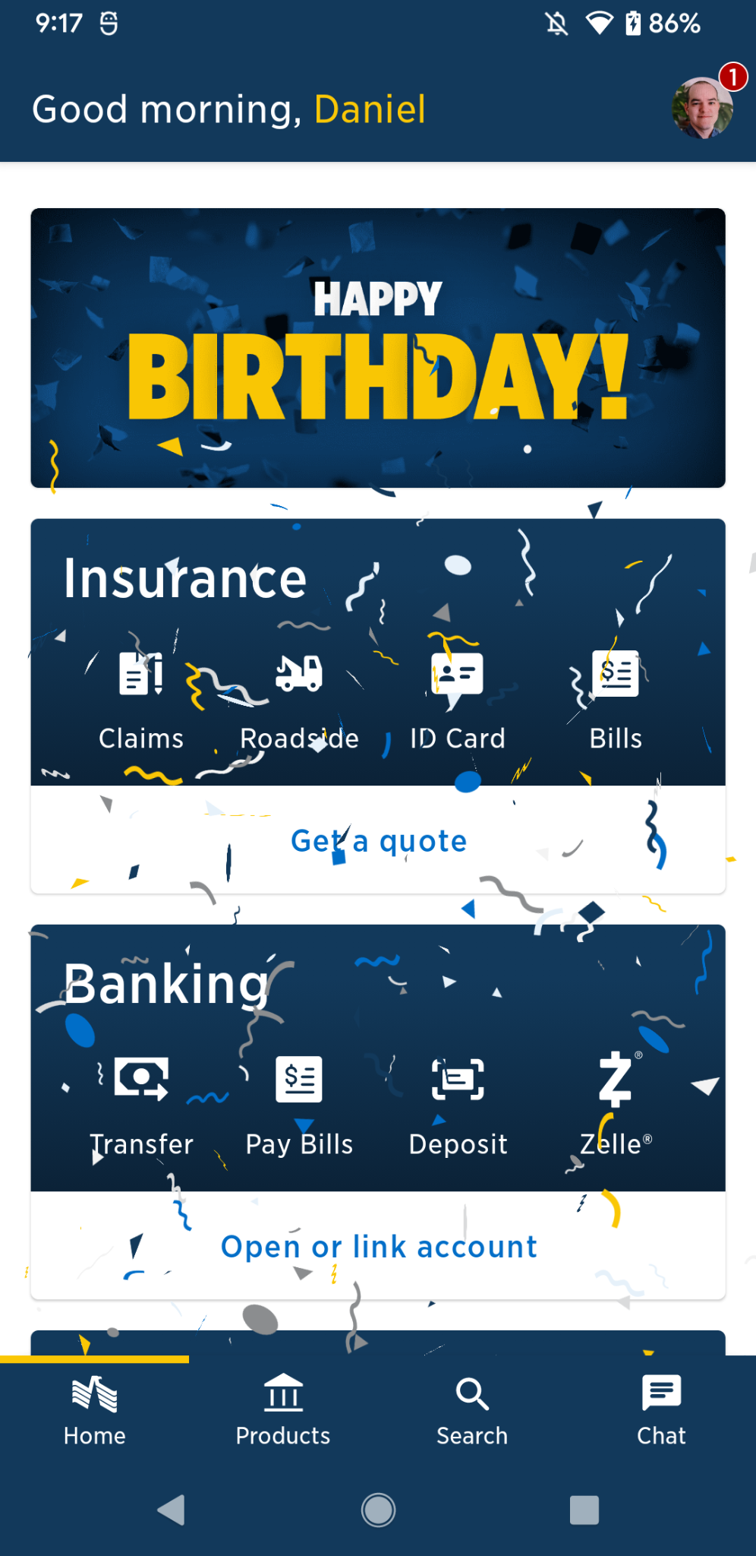
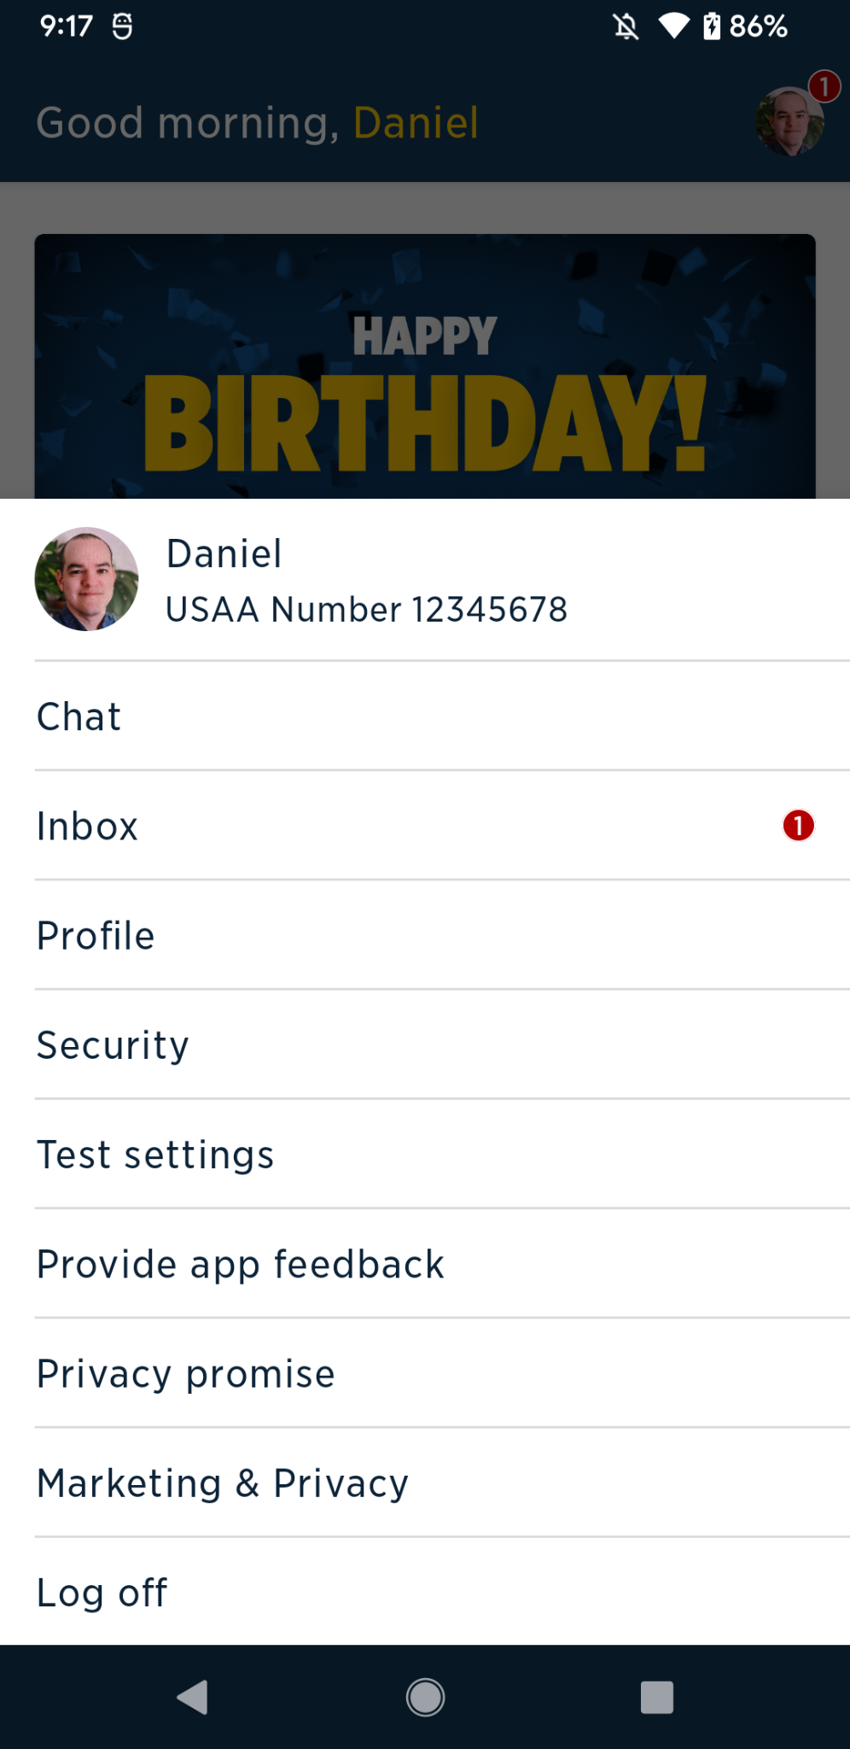
Things a Software Developer would make
Notes:
This was fun to make.
I wrote instructions for the computer that say
If users birthday, show birthday card, and show confetti
All image here are publicly accessible by USAA members

Slide 12
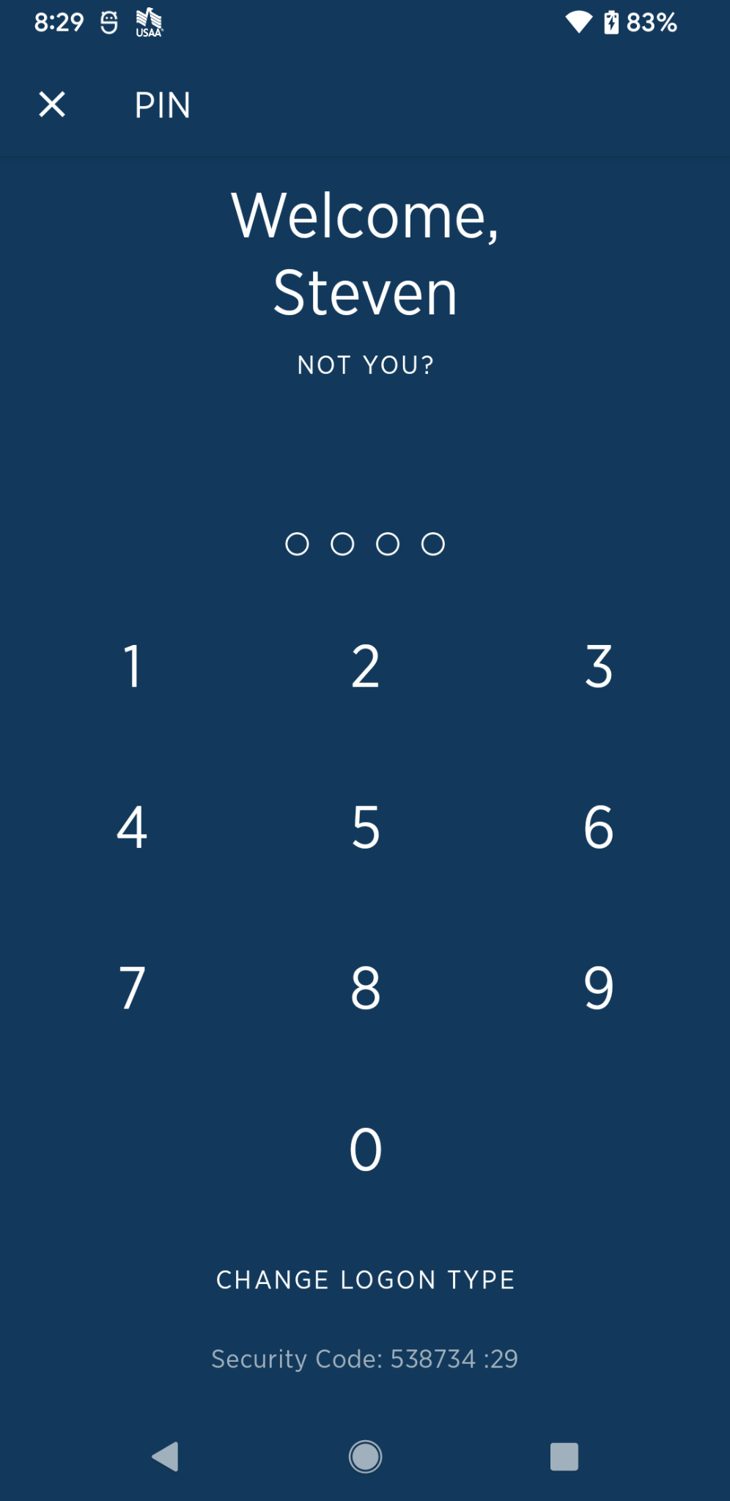
Things a Software Developer would make
Notes:
This was fun to make.
I wrote instructions for the computer that say
If users birthday, show birthday card, and show confetti

Slide 13
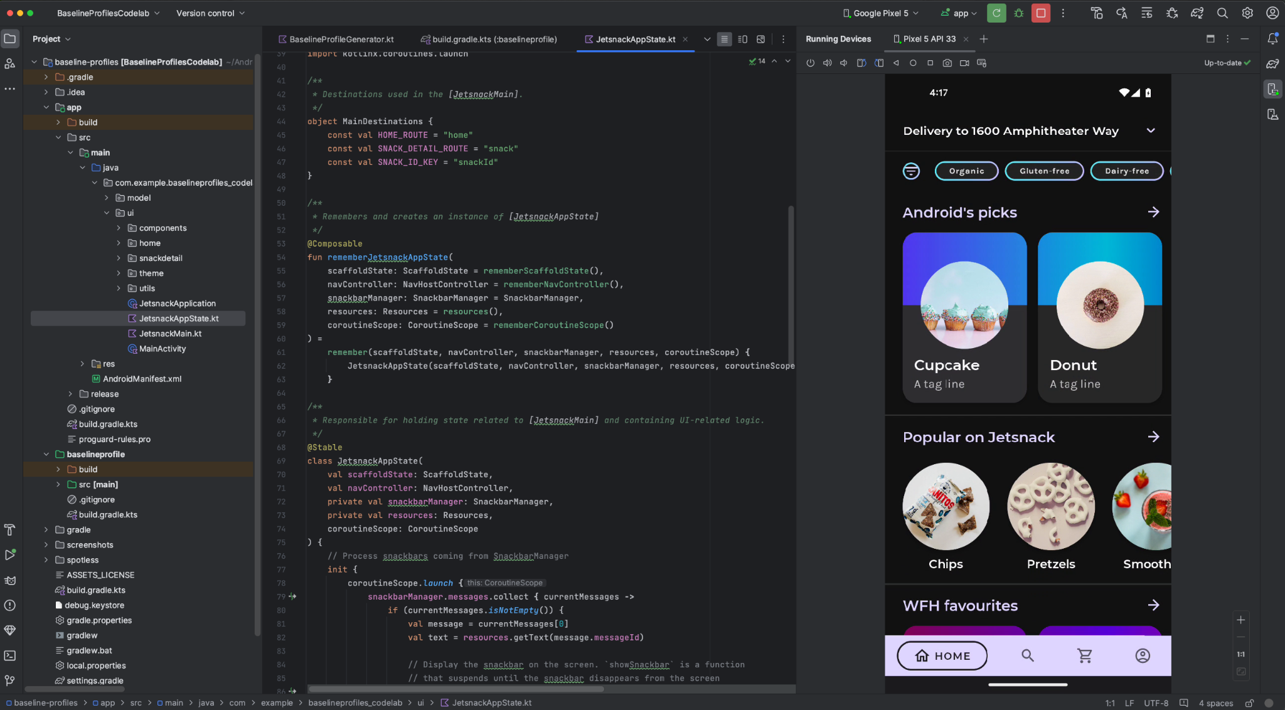
Notes:
Here is the tool I use to make software
Files, text documents, pictures, sounds.
Middle is a text document containing code, instructions for a computer

Slide 14
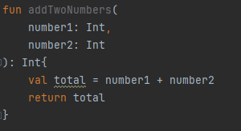
Sample Code
Notes:
Fun -> function -> reusable piece of code(computer instruction)
Number1
Number2
Total or sum = number 1 + number2
Then I return that total or sum
See, not so hard to read
Driving a car seems tough, but everyone learns, coding may seem tough, but I promise , anyone can learn
Same way you learn to play an instrument, or learn to do a backflip, it takes times

Slide 15
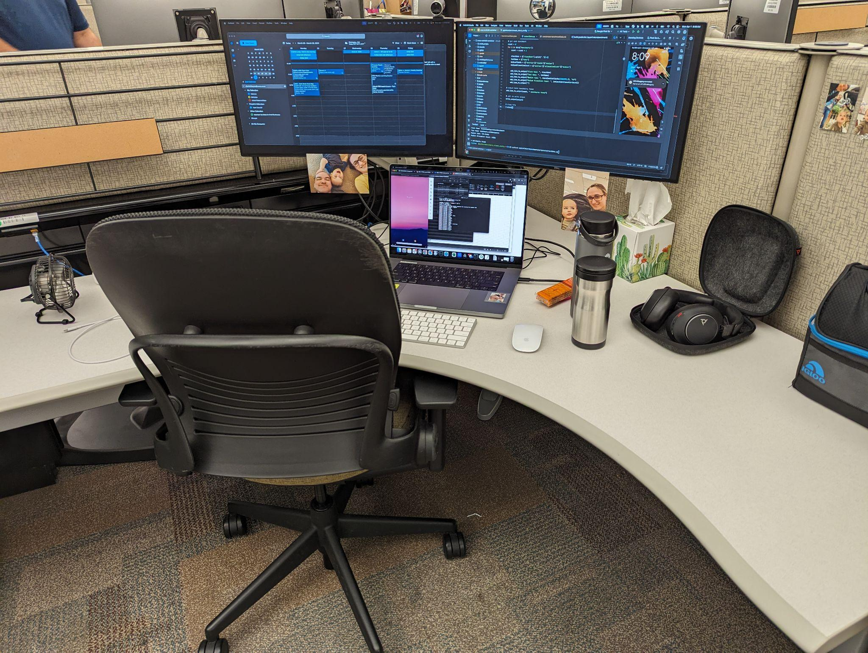
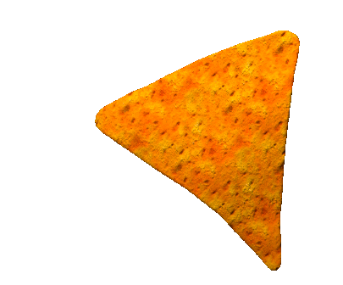
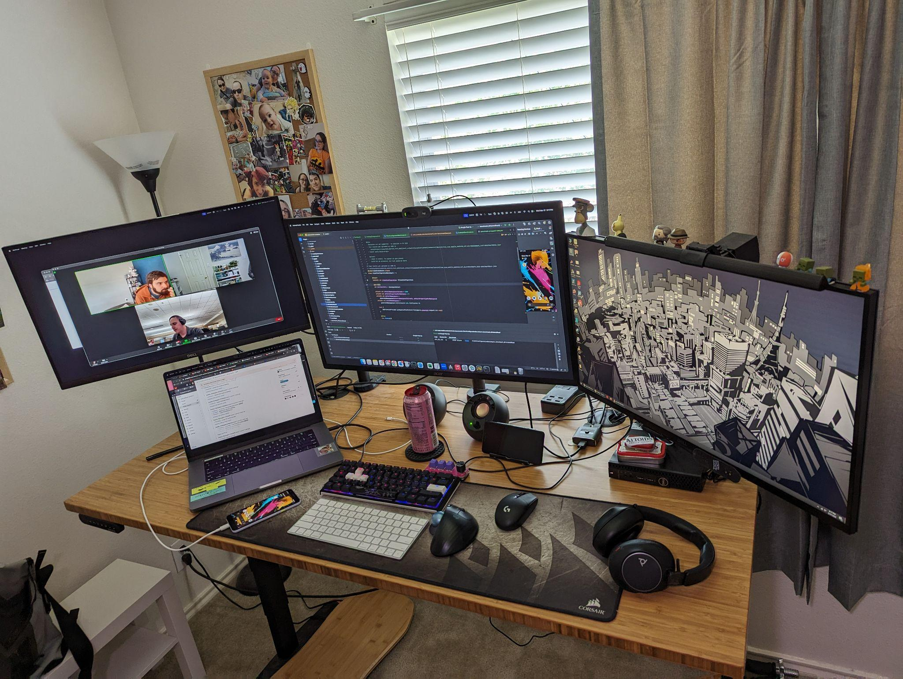

What my workplace looks like
OFFICE
HOME
Notes:
Talk about each one.
Work Flexible, maybe work from a bakery/coffee shop

Slide 16
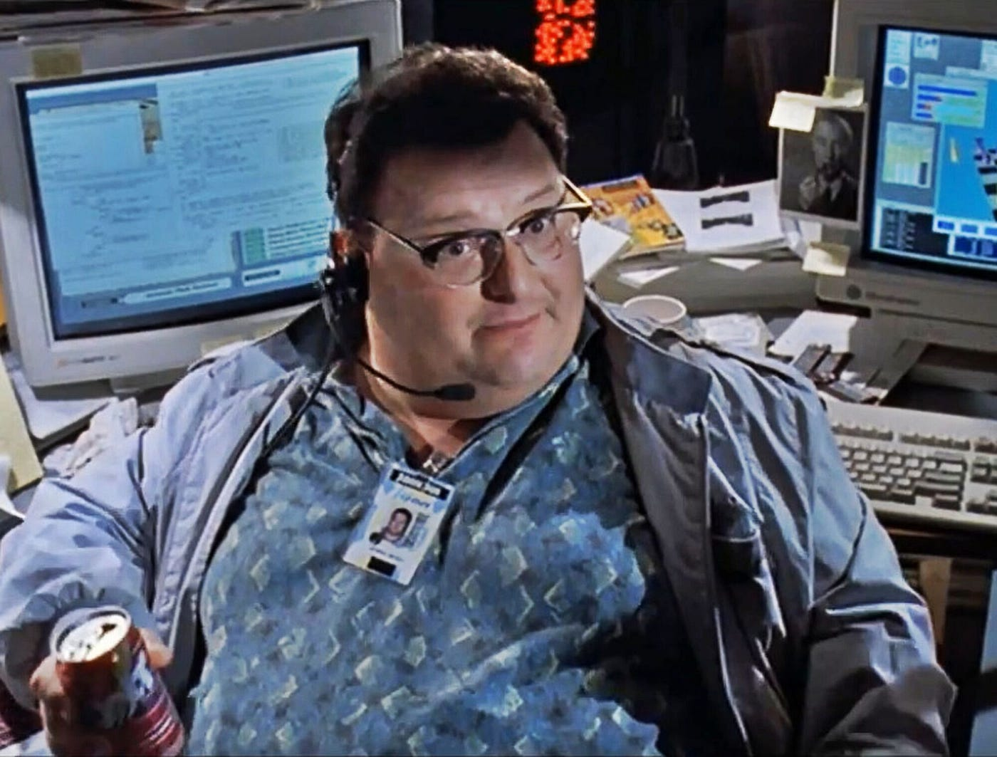
What does a Software Developer look like?
Notes:
Some people think people who work on computers look like this
Nerdy, sit at computer all days
But….the good thing is is that developers are diverse, and you don’t have to fit a specific mold

Slide 17
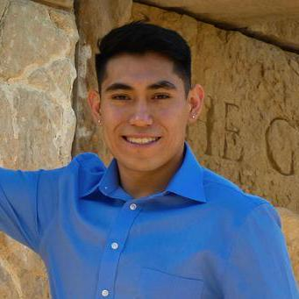
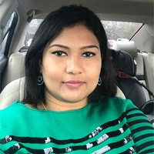

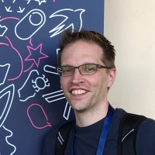
What does a Software Developer look like?
Notes:
Real developers I have worked with
Diverse set of people
no requirements other than typing
Other careers that have maybee unlikeable or impossible requirements
Police office - fit, able to run, quick, defense training?
NBA player - only 2 players currently under 6 feet
This 2023-2024 season 560 players, almost 1 in million (330 million)

Slide 18
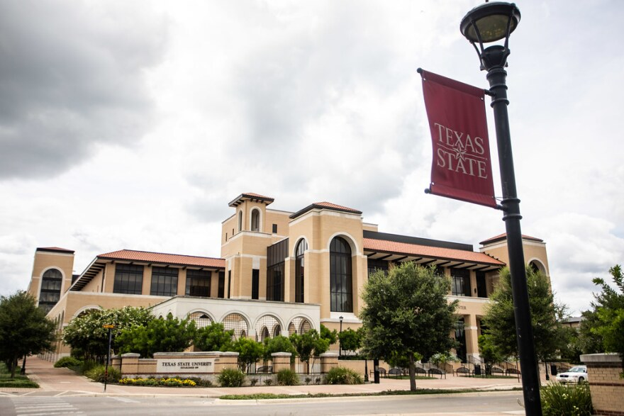

How did I get into my career?
I went to school and studied
Notes:
I went to college, and earned a degree in computer science after 4 years
Not all software development jobs need 4 years of college
Some can do 2 years, some people take online courses

Slide 19

Why is a career in computers good?
Lots of freedom
Pay
Always a need
Notes:
Bank manager - work strict hours, works at one location,
I have worked from home, a bakery, amd , multiple offices
Pay is good, even brand developer who are straight out of college make decent money
Demand - most people use some type of computer daily, and they need software, meaning they need someone to create it

Slide 20
Questions?

Slide 21
Thanks!
Does anyone have any questions?
addyouremail@freepik.com
+91 620 421 838
yourwebsite.com
Please keep this slide for attribution
Soft Colors UI Design for Agencies | by Slidesgo

Slide 22
Fonts & colors used
This presentation has been made using the following fonts:
Rubik
(https://fonts.google.com/specimen/Rubik)
Karla
(https://fonts.google.com/specimen/Karla)
#000000
#fcf6e8
#dbcfc3
#efc4b9
#fdbc96
#dac2cf
#d3e3d6

